Slide 1
Exercise 6
Huffman Codes
Slides adapted from material by
Profs. Chen Yue(Zhejiang University)

Slide 2
问题描述
In 1953, David A. Huffman published his paper "A Method for the Construction of Minimum-Redundancy Codes", and hence printed his name in the history of computer science. As a professor who gives the final exam problem on Huffman codes, I am encountering a big problem:
the Huffman codes are NOT unique. For example, given a string "aaaxuaxz", we can observe that the frequencies of the characters 'a', 'x', 'u' and 'z' are 4, 2, 1 and 1, respectively. We may either encode the symbols as {'a'=0, 'x'=10, 'u'=110, 'z'=111}, or in another way as {'a'=1, 'x'=01, 'u'=001, 'z'=000}, both compress the string into 14 bits. Another set of code can be given as {'a'=0, 'x'=11, 'u'=100, 'z'=101}, but {'a'=0, 'x'=01, 'u'=011, 'z'=001} is NOT correct since "aaaxuaxz" and "aazuaxax" can both be decoded from the code 00001011001001.
The students are submitting all kinds of codes, and I need a computer program to help me determine which ones are correct and which ones are not.

Slide 3
输入输出格式
Input Specification:
Each input file contains one test case. For each case, the first line gives an integer N (2 <= N <= 63), then followed by a line that contains all the N distinct characters and their frequencies in the following format:
c[1] f[1] c[2] f[2] ... c[N] f[N]
where c[i] is a character chosen from {'0' - '9', 'a' - 'z', 'A' - 'Z', '_'}, and f[i] is the frequency of c[i] and is an integer no more than 1000. The next line gives a positive integer M (<=1000), then followed by M student submissions. Each student submission consists of N lines, each in the format:
c[i] code[i]
where c[i] is the i-th character and code[i] is a string of '0's and '1’s.
Output Specification:
For each test case, print in each line either “Yes” if the student’s submission is correct, or “No” if not.

Slide 4
输入输出示例
Sample Input:
Sample Output:
Yes
Yes
No
No
7
A 1 B 1 C 1 D 3 E 3 F 6 G 6
4
A 00000
B 00001
C 0001
D 001
E 01
F 10
G 11
A 01010
B 01011
C 0100
D 011
E 10
F 11
G 00
A 000
B 001
C 010
D 011
E 100
F 101
G 110
A 00000
B 00001
C 0001
D 001
E 00
F 10
G 11

Slide 5
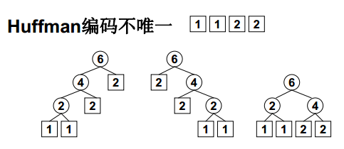
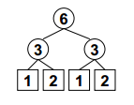
题意理解
注意：最优编码不一定通过Huffman算法得到！

Slide 6
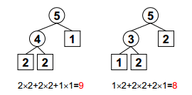
Huffman Codes特点
最优编码 —— 总长度（WPL）最小
无歧义解码 —— 前缀码：数据仅存于叶子结点
没有度为1的结点 —— 满足1、 2则必然有3
注意：满足2、 3可不一定有1！

Slide 7
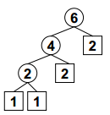
核心算法
1. 计算最优编码长度
MinHeap H = CreateHeap( N ); /* 创建一个空的、容量为N的最小堆 */ H = ReadData( N ); /* 将f[]读入H->Data[]中 */ HuffmanTree T = Huffman( H ); /* 建立Huffman树 */ int CodeLen = WPL( T, 0 );
int WPL( HuffmanTree T, int Depth ) {
if ( !T->Left && !T->Right ) return (Depth*T->Weight); else /* 否则T一定有2个孩子 */ return (WPL(T->Left, Depth+1) + WPL(T->Right, Depth+1)); }

Slide 8
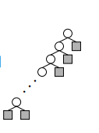

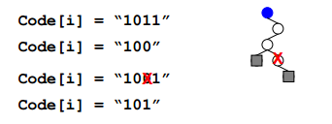
核心算法
2. 对每位学生的提交，检查
a. 长度是否正确
（注意： Code[i]的最大长度为 N-1 ）
b. 建树的过程中检查是否满足前缀码要求

Slide 9
完整代码
完整代码实现
https://pintia.cn/problem-sets/16/problems/671

Slide 10
Homework
在pintia.cn上实现tree部分的6道题，提交验证通过。将题目、代码和提交截图做成一个文件，提交到mooc.ybu.edu.cn
Deadline: 2019-11-17

Slide 11
Data Structures
To be continued…

